Slide 1


Assessment of discrete bubble models using two-fluid simulations of 2D rectangular fluidized beds
Richard B. Bates
Christos Altantzis
Ahmed F. Ghoniem
2014 NETL Multiphase Flow Science Conference
Tuesday August 5, 2014
3:30-4:00PM

Slide 2
Context: Modeling fluidized bed biomass gasification
Advantages of fluidized beds:
High levels of thermal inertia, mixing heat transfer
Feedstock flexibility
Challenges
Design
Scale-up
Optimization

Slide 3
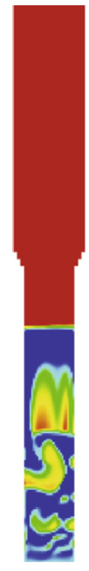
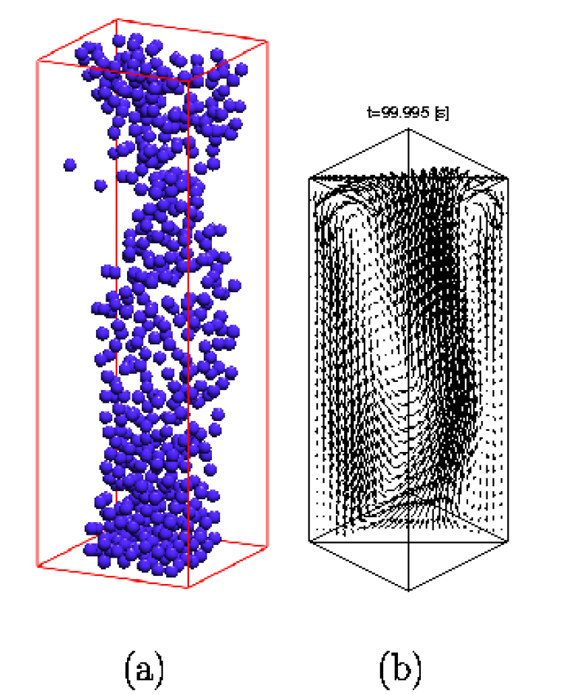
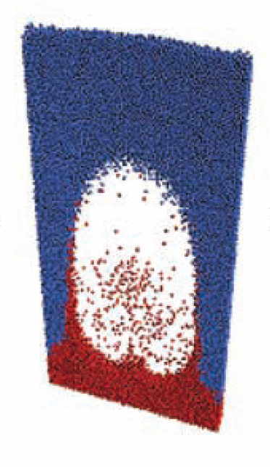
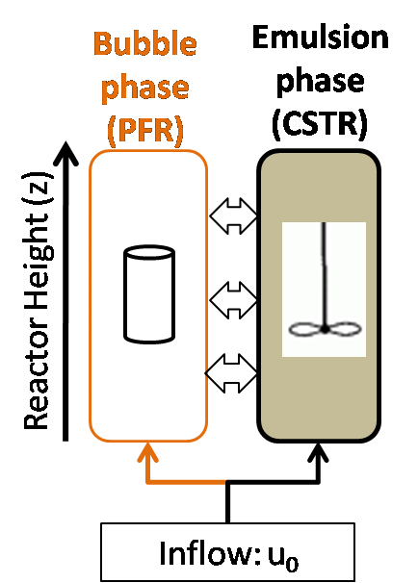
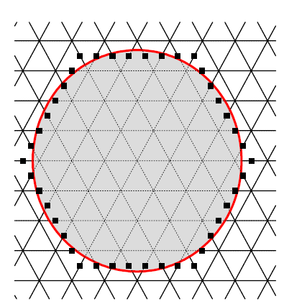
Multiscale fluidized bed modeling approaches (van der hoef et al., 2006, Werther, 2007)
Lattice Boltzmann Methods
(LBM)
Fluid-particle interaction
Discrete Particle Model
(DPM)
Particle-particle interaction
Multi-fluid model (MFM)
Particle-particle interaction; bubble behavior
Discrete Bubble model
(DBM)
Industrial scale, solids motion; bubble behavior
Two phase theory
(TPT)
Industrial-scale reactive simulations
10⁻⁵ m
10⁻² m
10⁻¹ m
10⁻⁰ m
10¹ m
Lower complexity/cost
Larger scale phenomena
Notes:
LBM DBM from van der hoef
250,000 core hours for DPM 3D case 4 inch by 7.5cm reactor
From Werther, 2007
Bench-scale fluidized bed reactors are roughly 30–60 mm
Pilot-scale units 450–600 mm, which should allow a reliable scale-up
Full-scale fluidized- bed reactors used in the chemical industry have diameters up to ca. 10 m.
Circulating fluidized bed combustors are even bigger with 200bed cross-sectional areas reaching 200 m2 (14mX14)

Slide 4
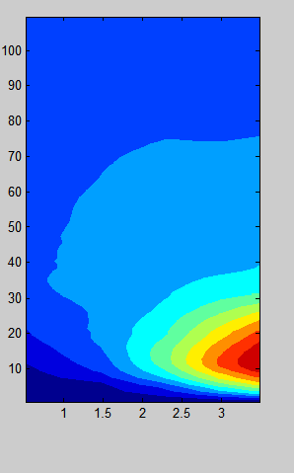
Importance of solids motion in large scale gasfication
“Consideration of [solids circulation] is necessary for the prediction of hot spots, locally reducing zones, and the optimum location of feed points” (Sarofim and Beér, 1979)
Modeling industrial scale gasifiers with CFD exceeds current computing limits, simplification necessary
Particle size: ~200-300 μm
Typical grid size: ~2-30mm
Industrial bed size: 3X3X10 meters
Cells required: ~10⁶-10¹⁰
Current limit: ~10^5 cells
Sub-grid modeling under development
Devolatilization often locally confined to feeding port areas
2-30mm
Computational element for MFM
Notes:
Example grid size calculations from: Myohanen and Hyppanen, 2011
Sarofim, A.F. & Beér, J.M., 1979. Modelling of fluidized bed combustion. Seventeenth Symposium (International) on Combustion, 17(1), pp.189–204.
Matsen, 1996
In large equipment, however, a much more powerful mechanism is due to large scale toroidal circulation patterns, up in the center and down at the wall. Gulf streaming concentrates gas bubbles in the center of the bed and greatly augments their velocity… This is a major reason why bubbling bed models to date have had limited success in describing behavior in large units.
Wischnewski et al., 2010: The semi-empirical modeling approach is still to be applied to model large industrial reactors
Geometry assumption 3X3X10m
Current state of the art:
366 249 elements (10^5) Liu et al., 2013 taking 173 h ~ 7 days 0.2m diameter bed, 6.5m tall.
“A major deficiency of models currently available is their inability to predict the circulation of solids, consideration of which is necessary for the prediction of hot spots, locally reducing zones, and the optimum location of feed points

Slide 5
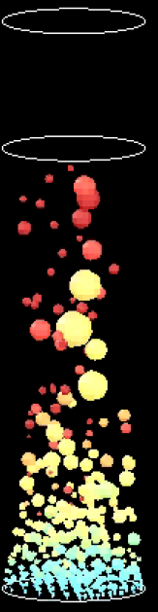
Discrete bubble modeling (DBM) approach
Halow et al., 2001
Model inputs
Bubbles of assumed size and frequency are introduced at the inlet:
Bubble evolution
Rise and coalesce with other bubbles
Pressure across bubbles is uniform
Solids phase assumed to be inviscid, incompressible,
Motion induced by superposition of rising and bubbles
Gas phase motion given by superposition of solid phase motion and Darcy (pressure driven) flow
Model outputs
Industrial scale gas/solids motion
2m x 6m bed
Notes:
“In a large-scale circulating fluidized bed furnace, the local feeding of fuel, air, and other input materials, and the limited mixing rate of different reactants produce spatially non-uniform process conditions” Myohen and Hypponen

Slide 6
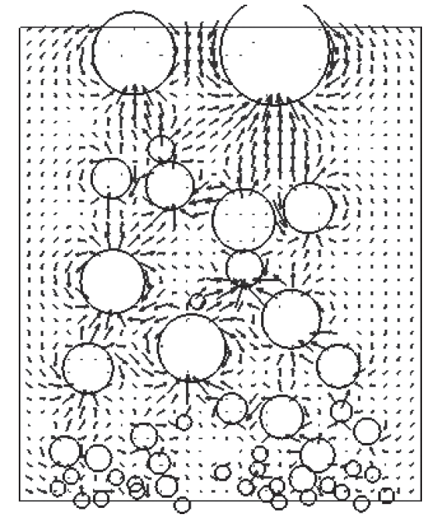
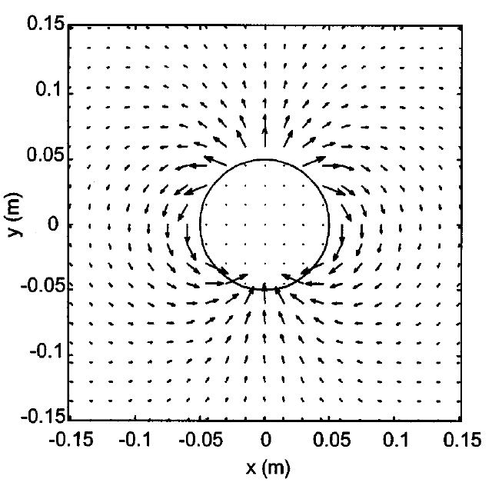


Implementation aspects of DBM
Existing models implementation:
Circular bubbles assumed to form at inlet
Solids motion is a superposition of dipole sources in whose strength is determined by the rise velocity of the bubble
Bubble rise velocities
Binary bubble interactions (Clift and Grace, 1970)
Linear system of N equations solved at each time step
Boundary effects
Mirror image points taken across bed boundaries
Usually only taken across vertical walls
Rigorous implementation
Boundary effects: Require an infinte series of mirror points across vertical boundaries and within bubbles to enforce no-flux
See (Kharlamov and Filip, et al., 2012 Journ Eng. Math.)
Source:
(Movehedirad et al., 2014 Chem Eng. Tech)
(DeKorte et al., 2001 AIChE Journal )
(Eames et al., 1994
Journal Fluid Mech.)

Slide 7


Numerical assessment of discrete bubble modeling (DBM)
Aims
Comparison of DBM with 2D multi-fluid models (MFM)
Variety of modeling parameters needed in DBM simulations:
Shell, wake, and drift fractions
Initial bubble sizes/frequencies
Isolated bubble growth
Isolated bubble rise velocities
Development of a model for steady-state solids motion in large scale fluidized beds
Expanded shell
0.42<ε<1
Bubble
ε~1
Emulsion ε~0.42
Bubble
ε~1
Wake
Notes:
Kozanoglu and Levy, 1991.
According to Yates: “Bubbles in fluidized beds of powders in groups A and B are surrounded by an extensive shell of gas and particles in which the porosity decreases exponentially to that of the emulsion phase remote from the bubble; there is no sharply defined boundary between bubble shell and emulsion:”

Slide 8






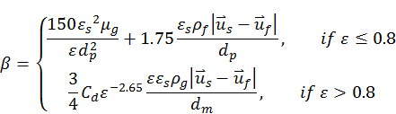


Multifluid Eulerian Governing Equations (MFIX)
Conservation of mass:
Conservation of momentum
Stress tensor constitutive equations
Interphase momentum transfer
Granular Temperature
8

Slide 9
2D rectangular bed MFM simulation setup
Front view
Input | Value
Grid dimensions (2D) | 0.5cm X 0.5cm (100 X 200 cells)
Inlet boundary conditions | Velocity
Superficial gas velocity | 0.39 (1.05 u₀/u_{mf})
H_{t}=100 cm
H_{bed}=30 cm
Bed material:
Glass beads, 678μm, 2500 kg/m³
u_{mf}=0.37 m/s (computed)
d_{t}=50 cm
9

Slide 10
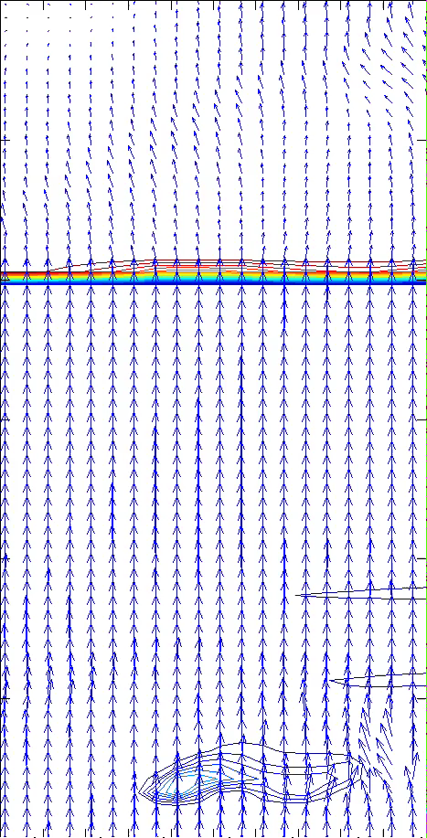
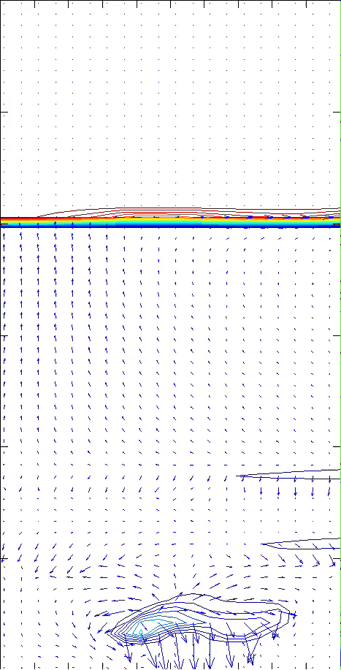
TFM simulation results: gas/Solid phase motion
Gas phase motion
Solid phase motion
Ascending bubbles drive solids motion
Bubbles act as pathways for gas flow
Gas motion mostly vertical
Bubble velocity appx. equal to interstitial velocity
Surface has a no-solids-flux boundary condition
Notes:
Movie size 6X3

Slide 11

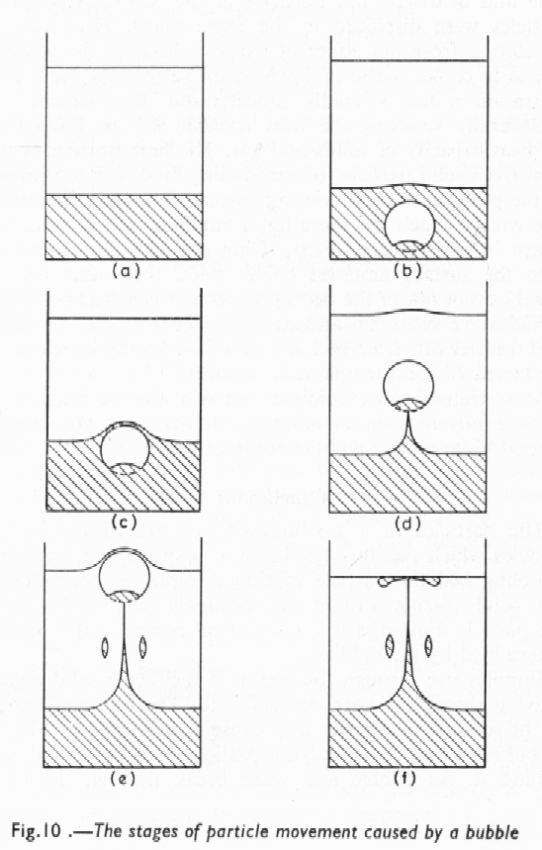
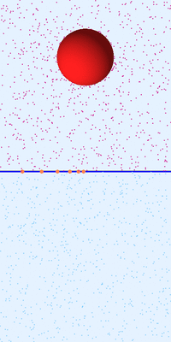
TFM simulation results: Bubble induced drift
Bubbling under incipient fluidizing conditions u₀=1.05*u_{mf}
Most of bubble induced mixing appears to be drift induced
No apparent “wake”
Schematic of particle movement from Rowe and Partridge, 1962 Particle movement caused by bubbles in a fluidized bed
Red/Blue: Indicates tracer concentration phase
Black/grey: Indicates voidage

Slide 12
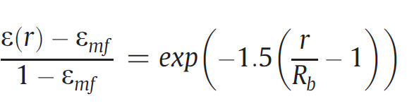
Experiments vs. simulations Variation in voidage around bubble
Expanded shell
0.42<ε<1
Bubble
ε~1
Emulsion ε~0.42
Experimental fit from Yates, 1994
8cm diameter spherical bubble
Discrepancy suggests expanded shell is a function of bubble size
Limited by CFD cell size (0.5mm)
Yates, 1994
Buyevich, 1995
Notes:
From incipientbubblng1.xls
Shell would indicate that as bubbles coalesce there is an increase in the visible bubble flow which agrees with previous experiments.

Slide 13

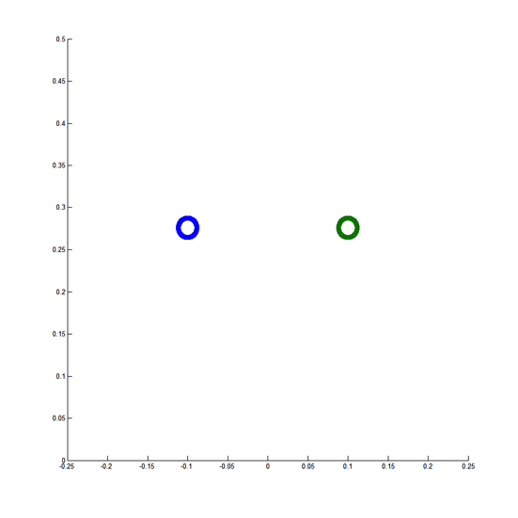
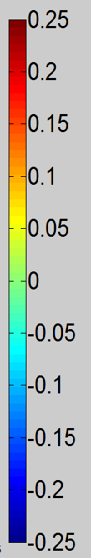
2D Discrete bubble models describe non-interacting bubbles qualitatively
2D CFD simulation
2D Discrete bubble model
Solid phase
Volume fraction
()
Maximum solids upwards solids velocity matches well
DBM doesn’t capture, bed surface effects
Solid phase
y velocity
(m/s)
Solid phase y velocity

Slide 14


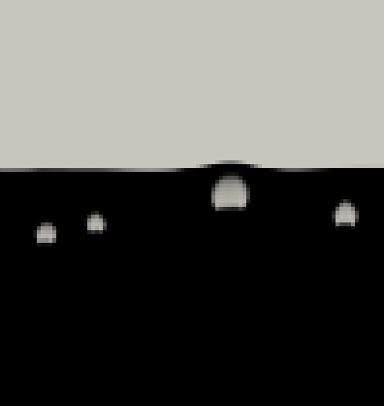
Simulation results: Bubble growth vs. time
1 Bubble
2 Bubbles
4 Bubbles
Notes:
Frame 820
(Sit and Grace, 1981)
Unsteady bubble growth, well in excess of that corresponding to the change in hydrostatic pressure, has been observed and accounted for in previous measurements of interchange transfer for single bubbles
(Rowe and Matsuno, 1971)
Injected bubbles generally grow as they rise through the bed

Slide 15
Simulation results: Bubble growth vs. height
1 Bubble
2 Bubbles
4 Bubbles
Notes:
Frame 820
(Movies to be inserted here)

Slide 16

Simulation results: Isolated bubble velocities vs. bubble size
Appear to be well fitted by:
Compares well with theoretical results

Slide 17

Summary of bubble growth/velocity
Simple correlation with height by Kunii used by Lim 2006 does not appear applicable in cases of multiple bubbles:
Bubble growth with height related to an unsteady balance of flow between bubble and emulsion phases
First identified by Jovanovic, 1979
Notes:
(Jovanovic, 1979)
For the exploding bubble regime the accumulation in the bubble is comparable to the throughflow
the bubbles growth indicates that there is more air flowing into the bubbles than leaving them. This is probably caused by a greater voidage behind the bubble than in front of it…
(Stephanakis, 1981)
Both of the cases analyzed indicate a higher voidage at the wake region of the bubble. It is worth noting that a small difference in voidage above and below the bubble can cause a significant gas accumulation in the bubble.

Slide 18
Conclusions
Expanded shell fractions
Results qualitatively similar to 3D Yates results
Differences expected for 2D/3D bubbles
Bubble growth
Linear growth with height for single, double bubbles
Unsteady interactions for >3 bubbles
Solids motion
Well described by DBM for non-interacting bubbles far from walls/surfaces
DBM needs to be modified to include wall effects appropriately through

Slide 19
Future work
Examine unsteady bubble formation mechanisms using MFM results
Quantify distribution of flow in bubble and emulsion phase
Generate appropriate correlations for industrial scale DBM simulations

Slide 20


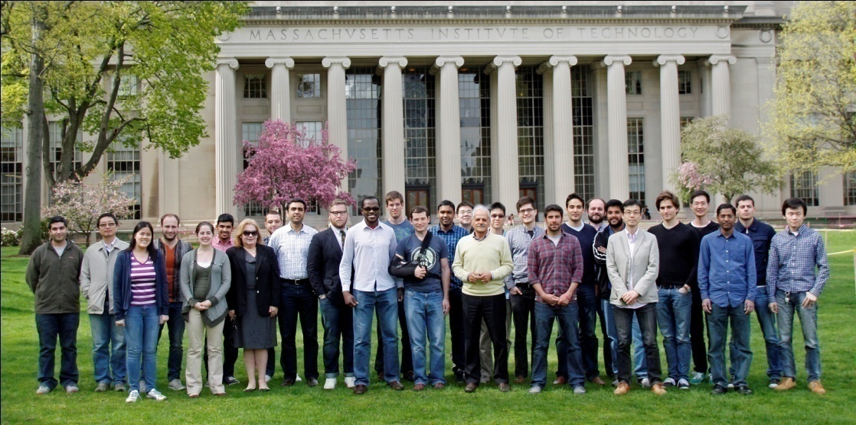

Acknowledgements
Sponsors: George Huff, Merion Evans, Cristina Botero
MITEI: Randall Field,
Advisors at MIT: Ahmed Ghoniem, Christos Altantzis
Colleagues at Reacting Gas Dynamics Lab

Slide 21
Sources Cited
Clift, R., Grace, J.R., 1970. Bubble interaction in fluidized beds. Chem. Eng. Prog. Symp. Ser. 66, 14–27.
Eames, I., Belcher, S.E., Hunt, J.C.R., 1994. Drift, partial drift, and Darwin’s proposition. J. Fluid Mech. 275, 201–223.
Halow, J.S., Pannala, S., Daw, C.S., 2001. Near real-time simulations of large Group B fluidized beds with a low order bubble model. Presented at the AIChE Annual Meeting, Reno, NV.
Kharlamov, A., Filip, P., 2012. Generalisation of the method of images for the calculation of inviscid potential flow past several arbitrarily moving parallel circular cylinders. J. Eng. Math. 77, 77–85. doi:10.1007/s10665-012-9532-6
Movahedirad, S., Ghafari, M., Molaei Dehkordi, A., 2014. A novel model for predicting the dense phase behavior of 3D gas-solid fluidized beds. Chem. Eng. Technol. 37, 103–112. doi:10.1002/ceat.201300432

Slide 22
Extra slides

Slide 23
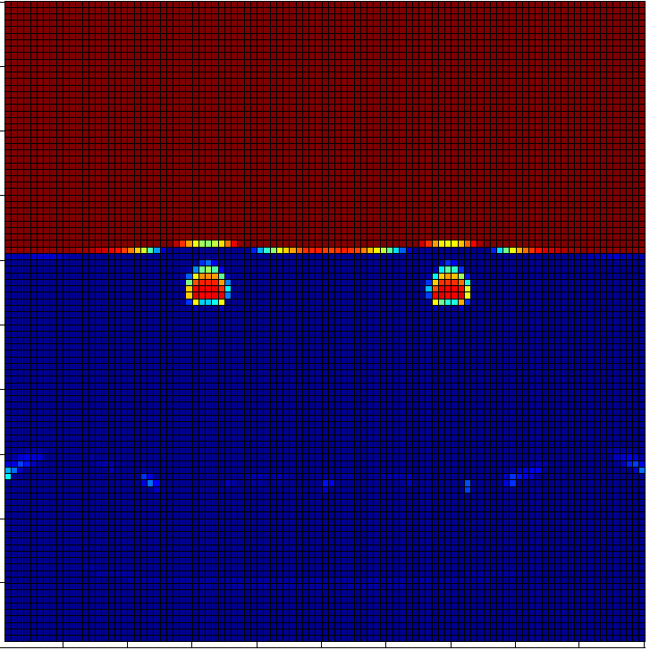

Voidage Delgado Uniform Frame 200

Slide 24
Slides for Addison’s/my presentation

Slide 25

Original two-phase theory (Toomey and Johnstone, 1952)
u_{b}
u_{e}=u_{mf}/ε
Bubble phase
(PFR)
Emulsion phase
(CSTR)
d_{b}
u_{b}
Reactor Height (z)
δ= (u₀-u_{mf})/(u_{b}-u_{mf})
(bubble fraction)
Assumptions:
Bubble phase is solids free ε_{b}=1
Solids in emulsion phase have 0 velocity: u_{s}=0
Emulsion gas and solids are well mixed
Emulsion is at minimum fluidizing conditions: u_{e}=u_{mf}/ε_{mf} ε_{e}= ε_{mf}
All excess gas u-(1-δ)u_{mf} flows through the bubble phase
Mean bed voidage given by: ε= δε_{b}+(1-δ) ε_{mf}
Inflow: u₀
Notes:
Scala and Salatino 2002:
Accordingly, the splashing zone is considered well stirred as regards both the solids and the bulk of the gas phase and isothermal as regards the gas phase. No secondary air injection is considered.
The height of the splashing region is calculated as the maximum height reached by bed solids in their ejection-fall-back trajectories .A conservative value of . = 1, i.e. initial particle
Upward velocity equal to that of the bursting bubbles, has been assumed.
been assumedin the computations.
MBS pattern: Fuel particles remain segregated at the bed surface as far as devolatilization is active. Once devolatilization is complete, char particles are assumed to be evenly dispersed throughout the dense phase of the bed.
The average size of the fine char particles is considered as an input parameter

Slide 26
θw
Abubble
Atri
Apie
Apie
A_w
45
90
135

